Slide 1
Assignment 2 Task 2 Defend
By Oliver Williams and Patrick Johnson
Tutor: Clinton Hayes
GitHub Link:

Slide 2
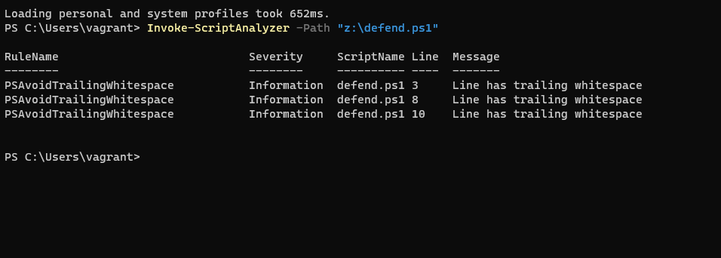
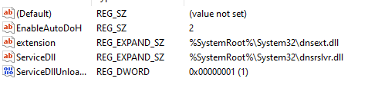

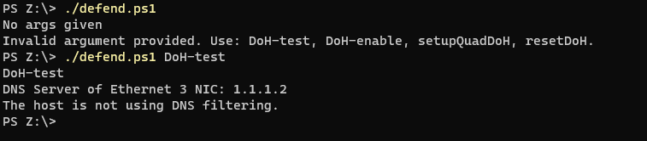
Pre-Testing
4. Document your code
Using PSScriptanalyzer to clean code
5. Enable the DNS over HTTPS feature on Win11.
A.
B.

Slide 3
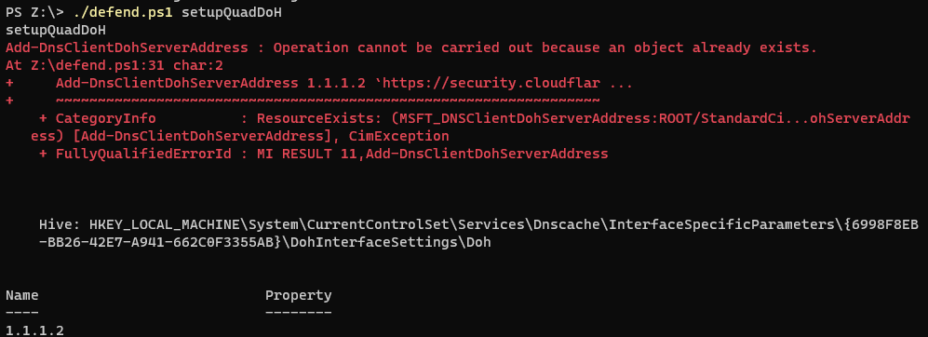
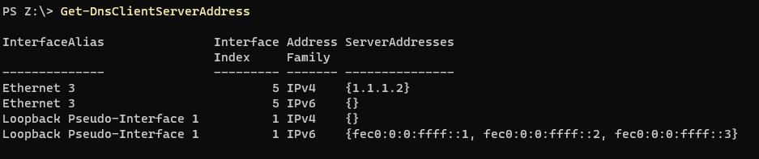
Pre-testing
6. Enable DoH on Ethernet 3 using the registry

Slide 4
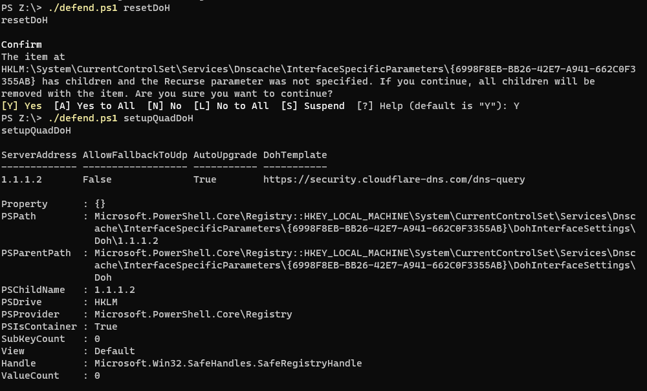
Post-Test
7.
8.

Slide 5
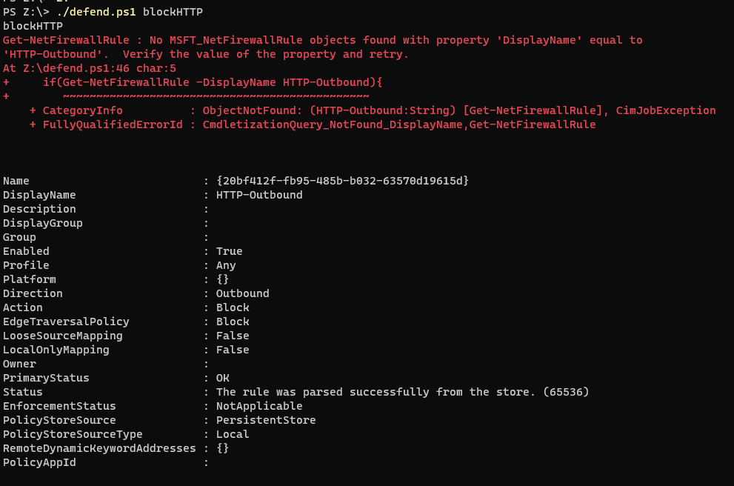
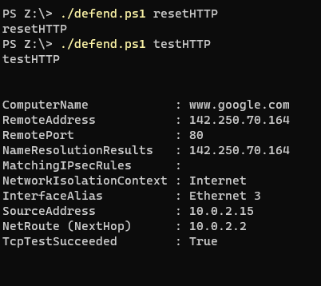
Configure the Windows 11 Firewall to block HTTP traffic
The error present is just checking if there a rule already present in the firewall.

Slide 6
References
Set-dnsclientserveraddress (DnsClient) (2022) (DnsClient) | Microsoft Learn. Available at: https://learn.microsoft.com/en-us/powershell/module/dnsclient/set-dnsclientserveraddress?view=windowsserver2022-ps (Accessed: 27 August 2023).
Test-netconnection (nettcpip) (2022) (NetTCPIP) | Microsoft Learn. Available at: https://learn.microsoft.com/en-us/powershell/module/nettcpip/test-netconnection?view=windowsserver2022-ps (Accessed: 27 August 2023).
Set-netfirewallrule (netsecurity) (2022) (NetSecurity) | Microsoft Learn. Available at: https://learn.microsoft.com/en-us/powershell/module/netsecurity/set-netfirewallrule?view=windowsserver2022-ps&viewFallbackFrom=windowsserver2022-pshttps%3A%2F%2Flearn.microsoft.com%2Fen-us%2Fpowershell%2Fmodule%2Fnetsecurity%2Fset-netfirewallrule%3Fview%3Dwindowsserver2022-ps (Accessed: 27 August 2023).

